Slide 1
Automated drone landing detection using YOLO and SVM
Eduardo Lopez, Jared Ricks

Slide 2
Project Overview
Goal:
Determine whether the drone is aligned for landing using a DNN and Machine Learning Algorithms
Methods:
Captured videos of both aligned and misaligned landing.
Extracted .jpg captures from the videos.
Capture location of landing pad using YOLO.
Calculate the center and the area of landing pad.
Create a dataset for training.
Train SVC to predict if aligned or misaligned.
Evaluate model accuracy and performance.

Slide 3
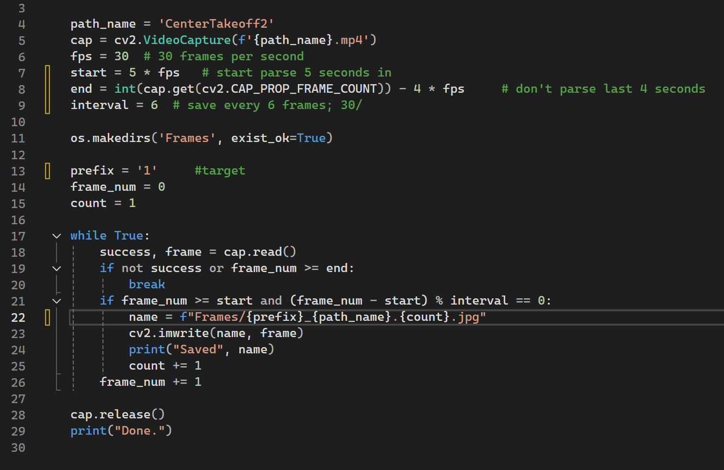
Data collection
Capture drone footage
5 aligned and 5 misaligned
Create script to parse .mp4 to .jpg
Save every 6th frame
Save with prefix 0_ for misaligned and 1_ for aligned
Aligned captures, 213
Misaligned captures, 164

Slide 4
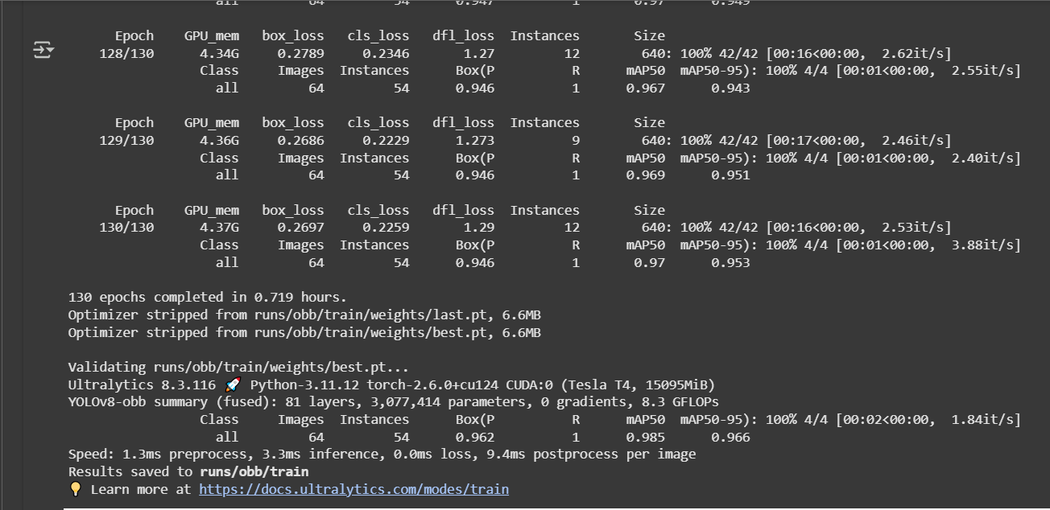
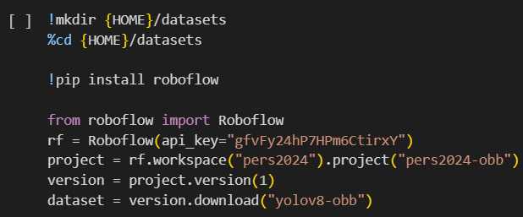
Training YOLOv8-obb model
We trained on a dataset created using Roboflow
We found 130 epochs to be best

Slide 5
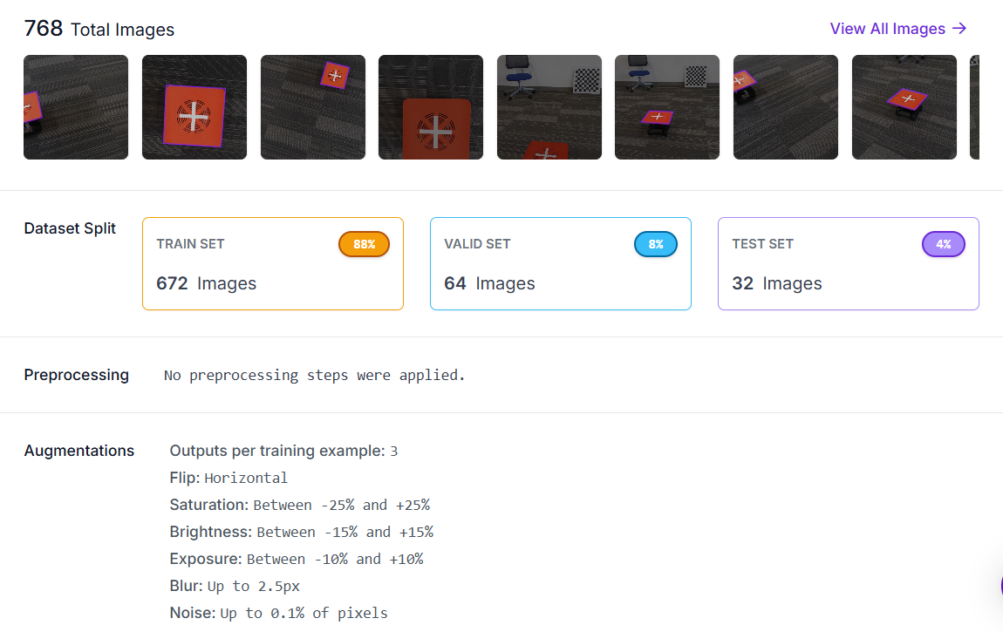
Preprocessing a Yolo Dataset using Roboflow
Used Classification instead of Object Detection
Why?

Slide 6
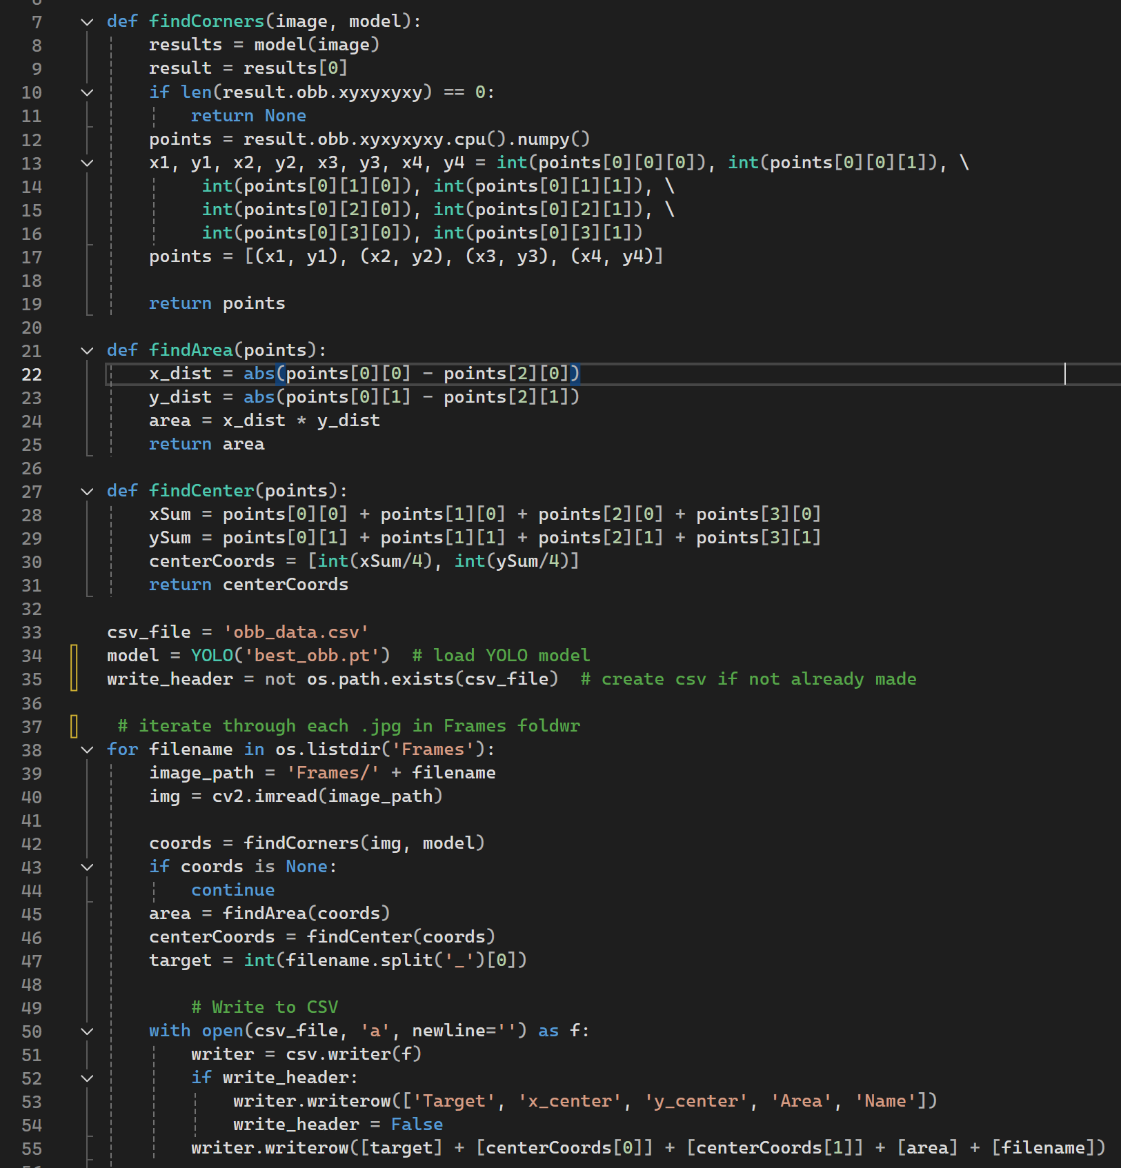
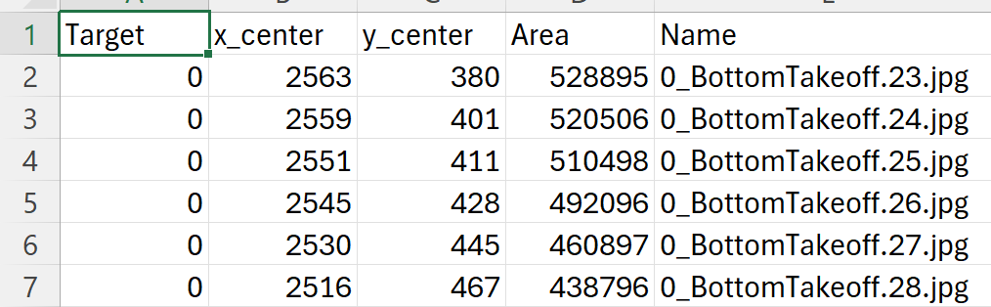
Building the CSV Dataset
Extract four corners from YOLO
Validate YOLO obtained the corners
Compute the area
Find the center of the landing pad
Create a csv file
Load in the coordinates and area
Assign labels based on 0_ or 1_
Saved results in obb_data.csv

Slide 7
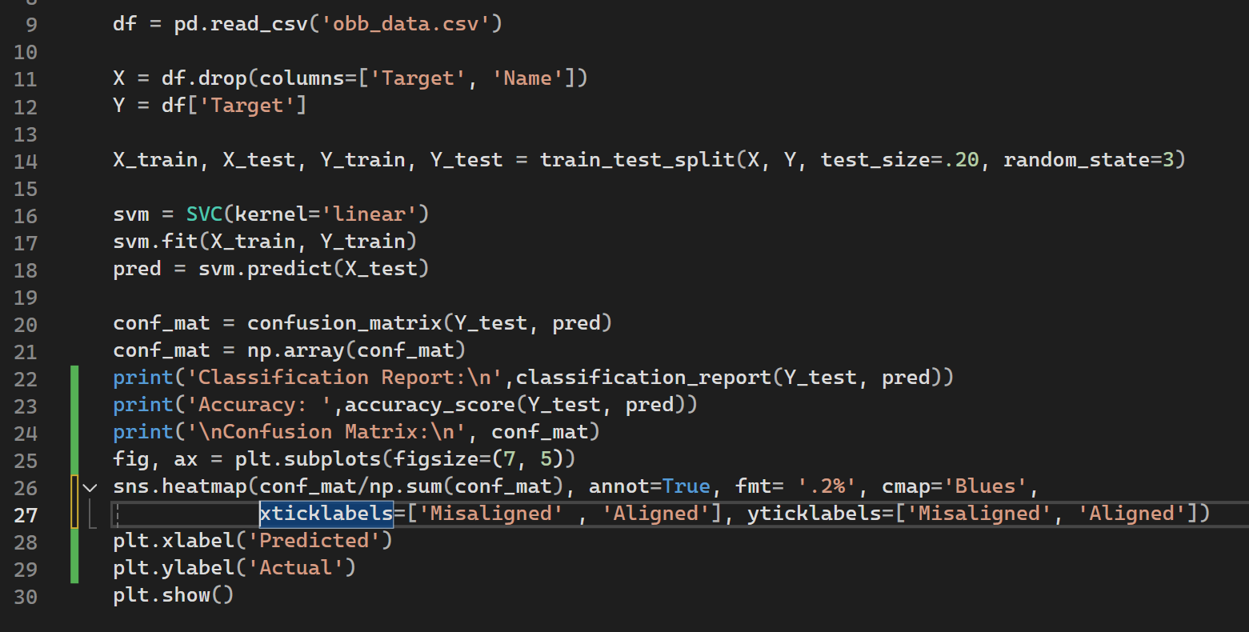
Model Training
Load in obb_data.csv
Separate target and feature labels
Split data 80/20, train/test
Train SVC using Linear kernel
Performance evaluation; classification report, accuracy score, and confusion matrix.
Predict HeavyDrift.mp4 live video

Slide 8
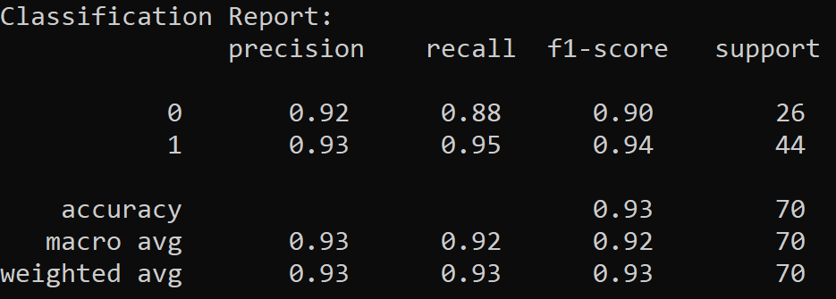
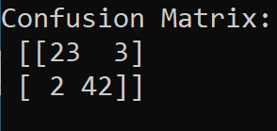

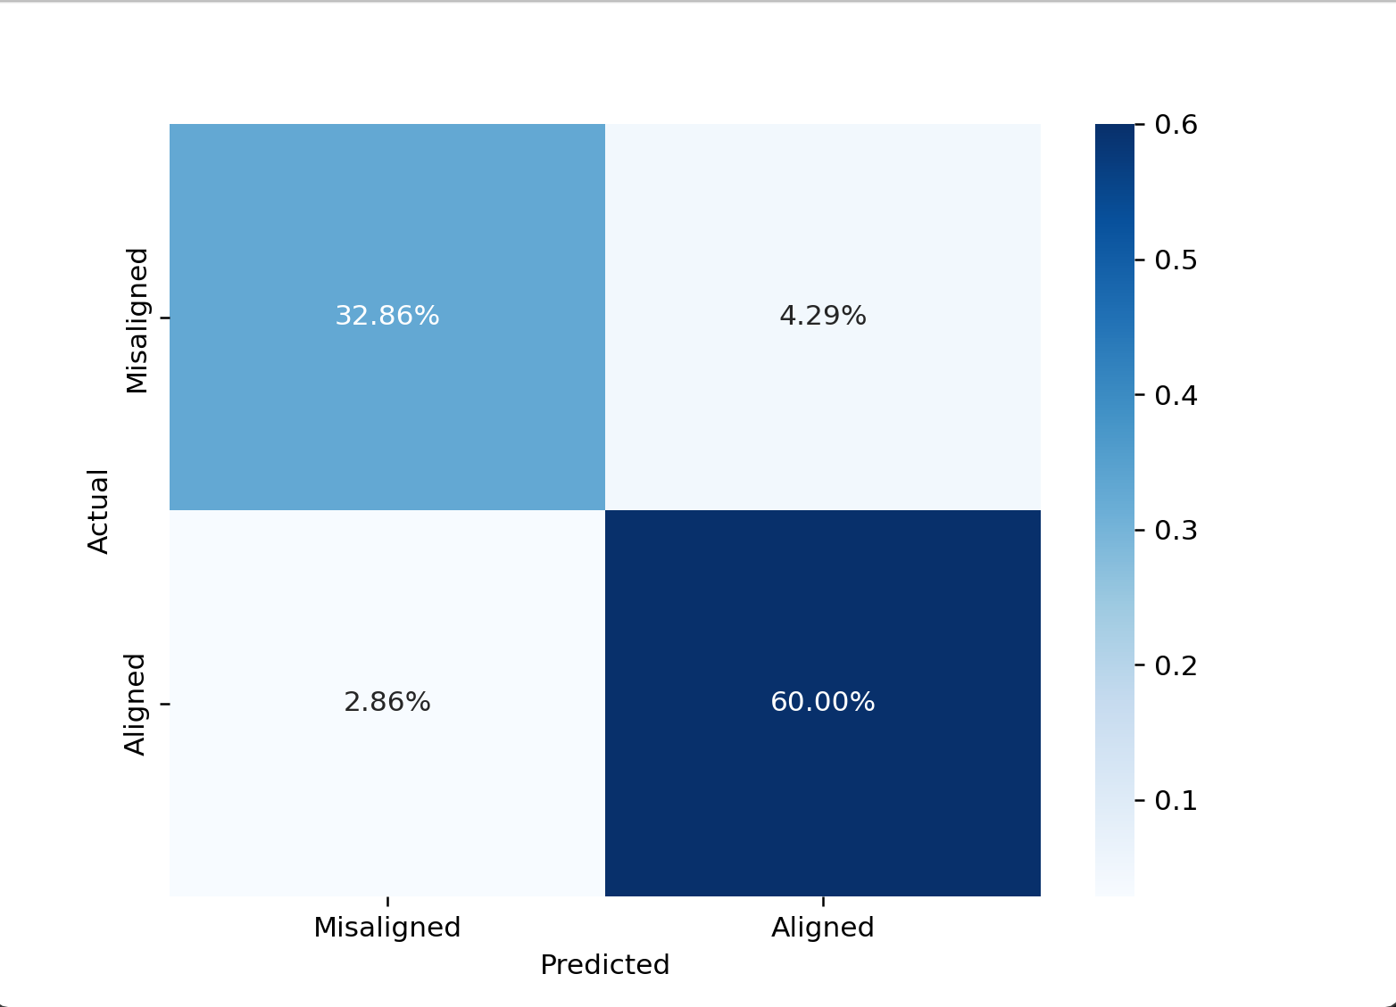
Results of SVM
65/70 captures predicted were correct
Performed slightly better for aligned captures
Low false positives and false negatives
Performance was well balanced between classes

Slide 9
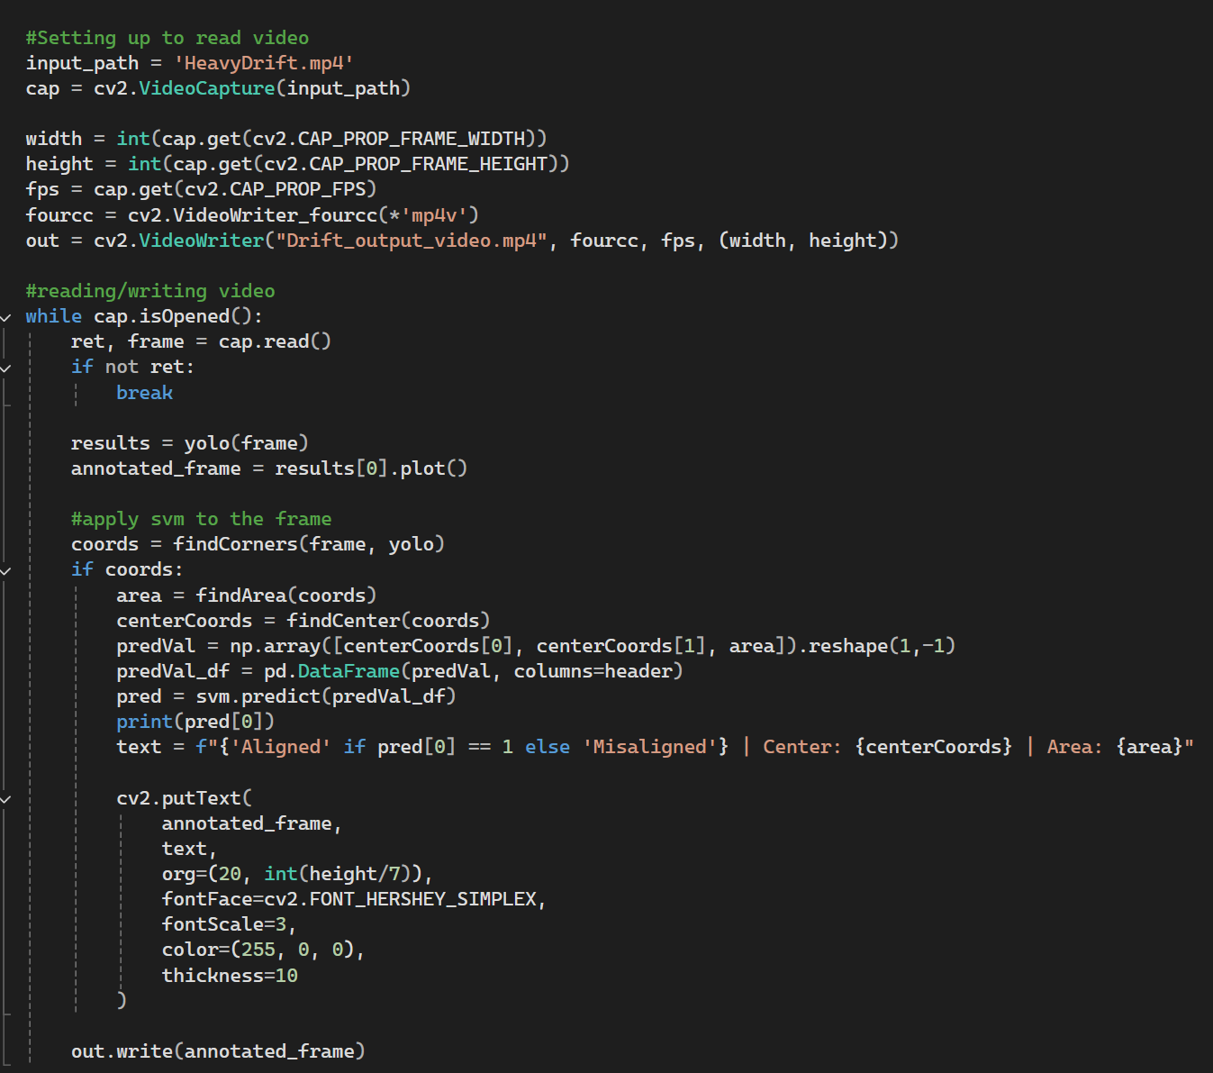

Results of Video

